Slide 1







CHOCO TALES
Every Bite Tells a Story
Presented By : Kashak Jain

Slide 2


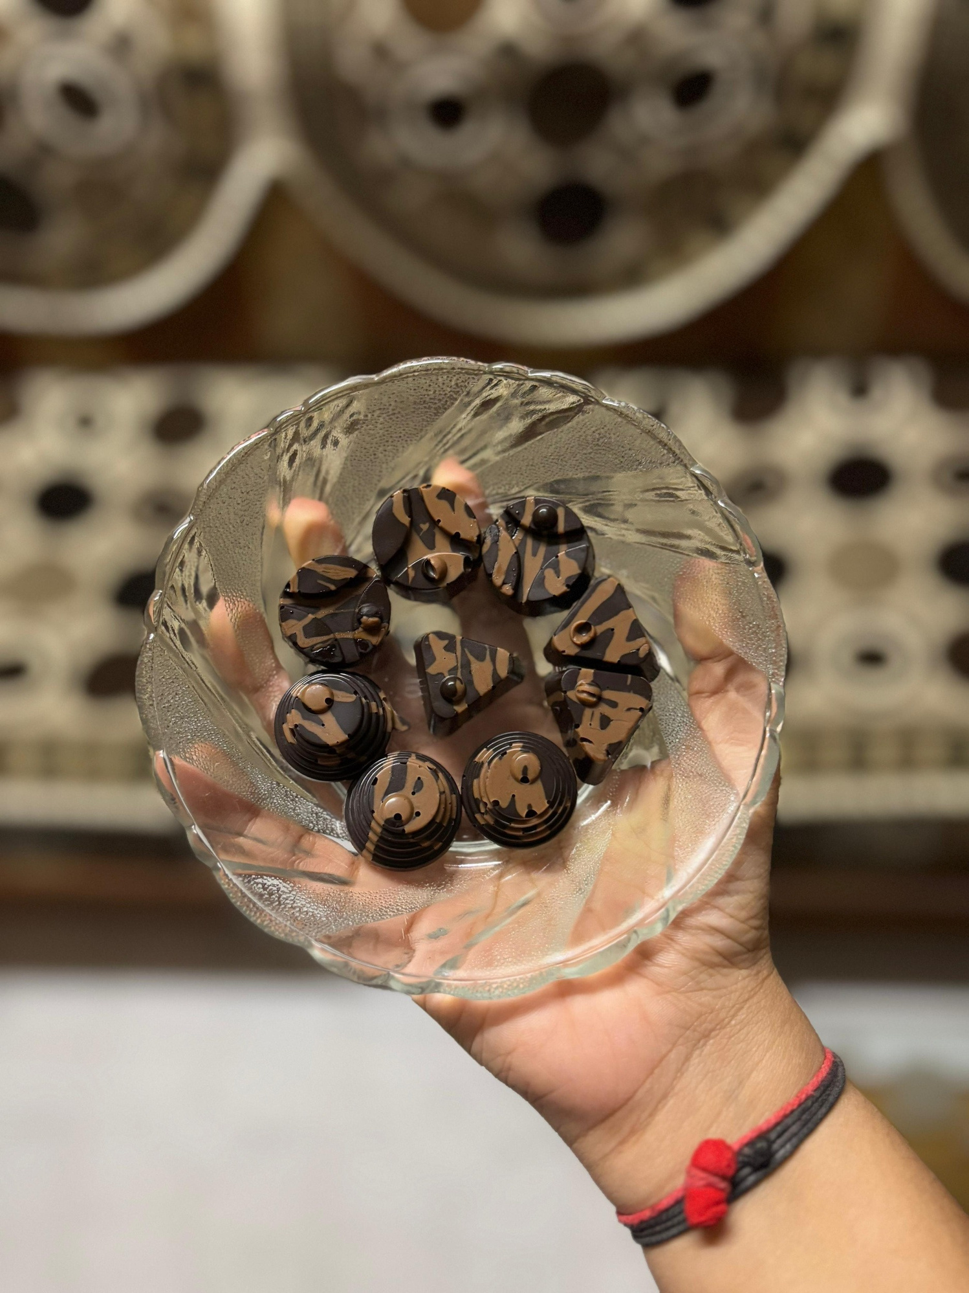
ABOUT US
Choco Tales is a homegrown chocolate brand specializing in handcrafted chocolates made with love. Our mission is to deliver premium, delicious, and customizable chocolates for every occasion.

Slide 3


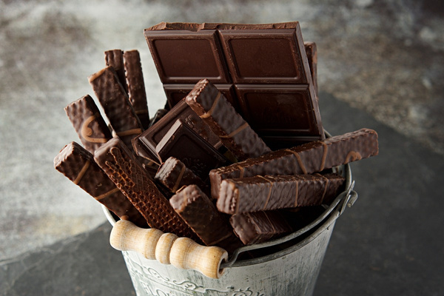


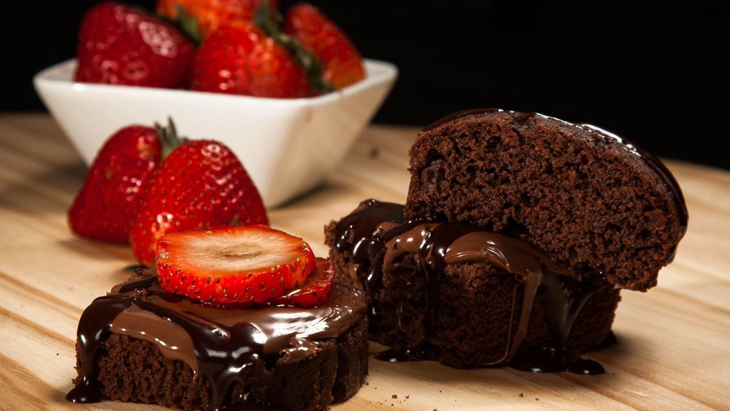

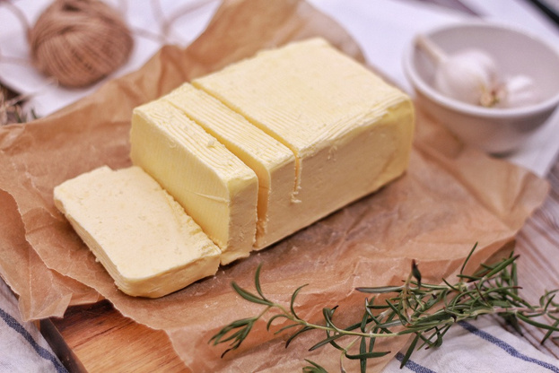

MISSION
To create delightful, high-quality chocolates that bring joy to every bite.
VISION
To become a go-to brand for premium handmade chocolates, offering unique flavors and elegant packaging for all celebrations.

Slide 4



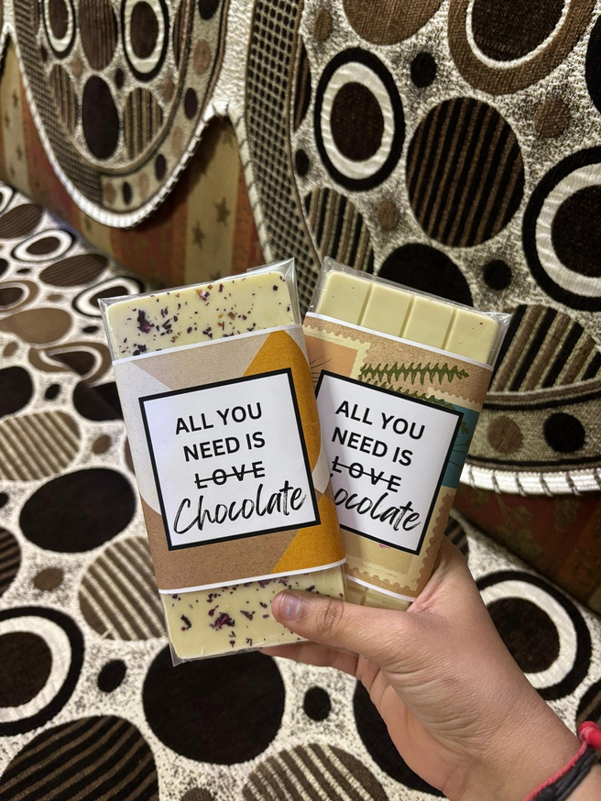
PRODUCTS
We offer a variety of handcrafted chocolates: Classic: (Milk, Dark, White)
Filled: (Nuts / Dry fruits & Oreo)
Customized Chocolates: (Name, Logo, Theme-based)
Gifting Boxes: (Corporate, Wedding, Festive, Birthdays)
Note: All the mentioned flavours are available in both bites & bars.

Slide 5

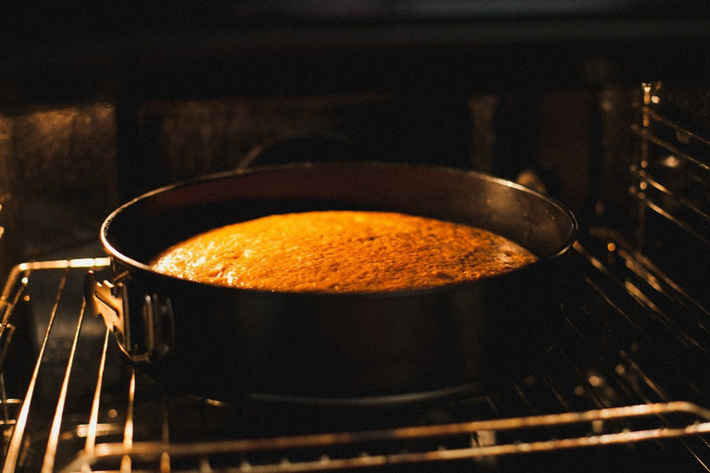




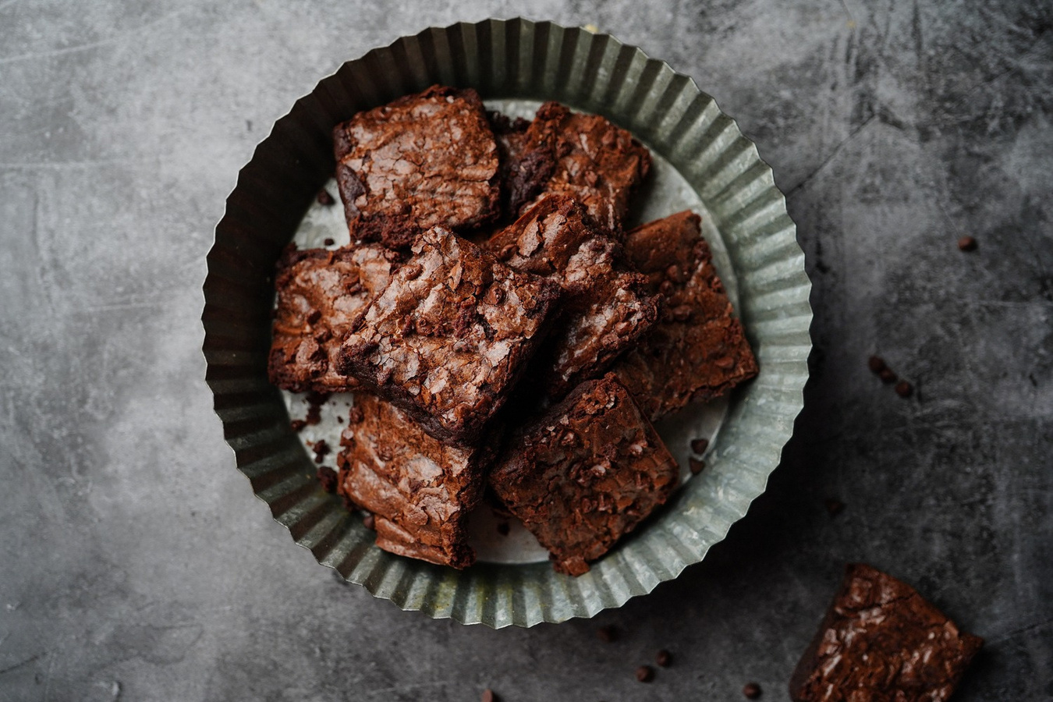


What makes Choco Tales special?
Premium Ingredients – Only high-quality cocoa and natural flavors.
Handcrafted with Love – Small-batch chocolates for a personalized touch.
Customization Available – Tailor-made chocolates for special occasions.
Elegant Packaging – Perfect for gifting and celebrations.
No Preservatives, No Artificial Flavors – Pure & natural taste.
UNIQUE SELLING PROPOSITION (USP)

Slide 6


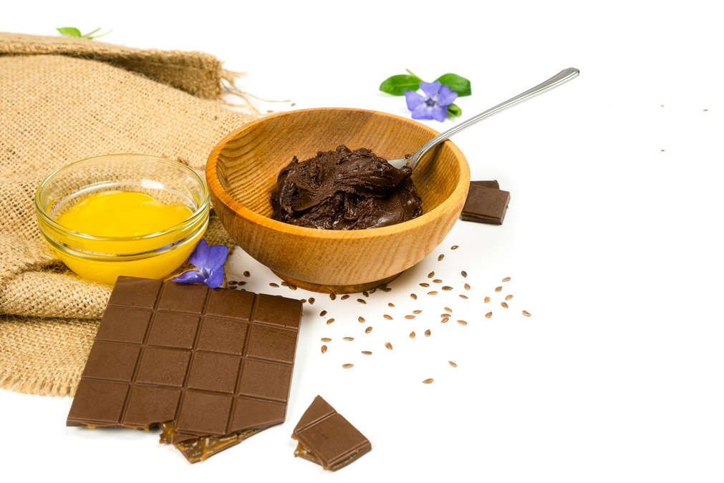
TARGET AUDIENCE
Chocolate Lovers – Anyone craving high-quality handcrafted chocolates.
Gifting Purposes – Perfect for birthdays, anniversaries, and special events.
Corporate Clients – Bulk gifting for employees & clients.
Wedding & Festive Celebrations – Custom gift boxes for special occasions.
Children & Families – A treat for all ages!

Slide 7
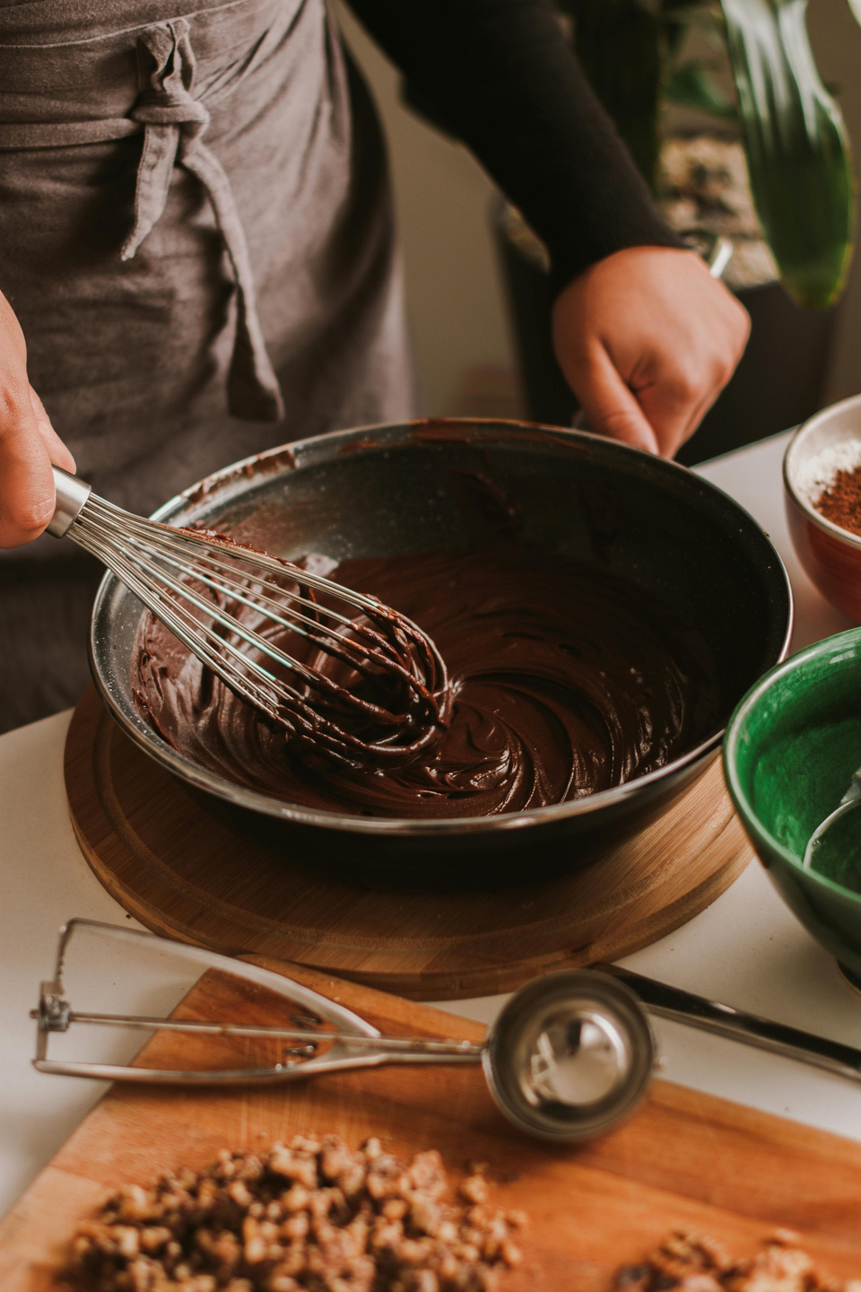

Pricing Range:
PRICING & PACKAGING
Chocolates bites starts from ₹70 (5 bites per box).
Chocolate bar range from ₹150 / per bar.
Packaging Options:
Elegant gift boxes (Festive/Wedding/Corporate)
Personalized packaging (Name, Theme-based)
Eco-friendly packaging available

Slide 8


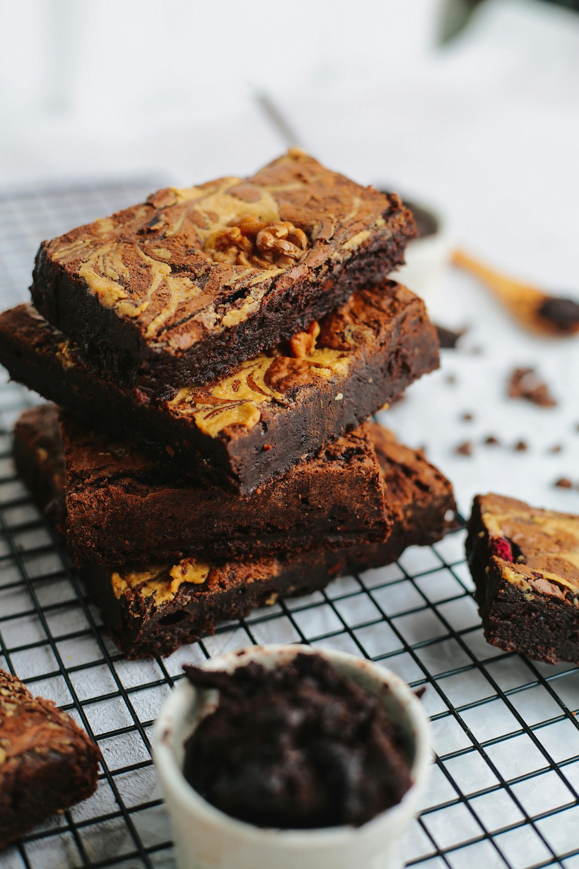

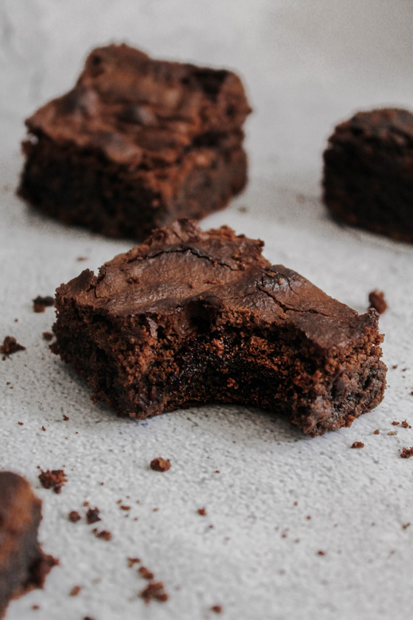
MARKETING & PROMOTION STRATEGY
How we plan to grow Choco Tales:
Social Media Marketing – Engaging Instagram & WhatsApp promotions.
Influencer Collaborations – Partnering with food bloggers & influencers.
Word of Mouth – Customer referrals & testimonials.
Festive & Seasonal Offers – Discounts & special edition chocolates.
Offline Promotions – Selling through local events, exhibitions, and pop-up stores.

Slide 9


BUSINESS GOALS & FUTURE PLANS
Short-Term Goals (Next 6-12 Months):
Build a strong online presence on Instagram.
Participate in local events/exhibitions.
Expand product offerings with new flavors.
Collaborate with small cafés and bakeries.
Long-Term Goals (1-3 Years):
Launch an official website & online store.
Open a small chocolate boutique or café.
Partner with corporate clients for bulk gifting.
Introduce international flavors & premium collections.

Slide 10


CONTACT & CALL TO ACTION
Order Now!
Instagram: @thechocotales__ WhatsApp: 8460374931
DM us for custom orders & inquiries!
Indulge in the magic of handmade chocolates. Every bite tells a story!

Slide 11
THANKYOU

